Slide 1
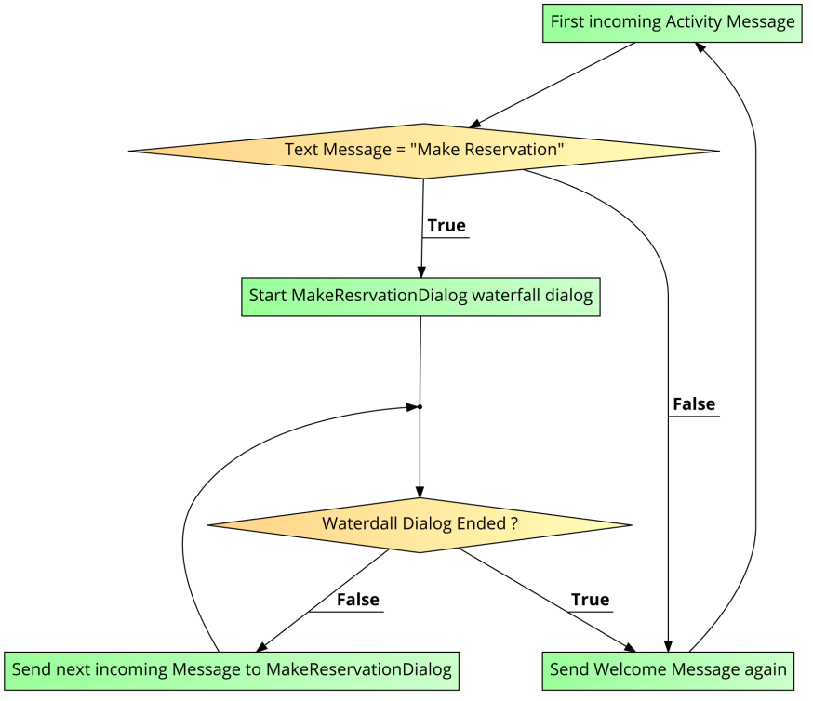
API
QnAMaker – None Type Intent
(QnAMaker.ai)
Luis – Intent and Entity Creation
(luis.ai)
Generate Key
Generate Key
BotBuilder ,Activity Handler Package(javascript)
deployment
AZURE PORTAL – Bot Creation
Integration
Teams
webchat

Slide 2
Activity Handler(RRBOT)
Suggested Actions
Component Dialogs
Recognizers
State Management
Welcome Message
Waterfall Dialog
LUIS
QnA Maker
User State
Conversation State
Dialog State
Number Prompt
Prompt Validators
Date & Time prompt
Confirm Prompt

